Slide 1
Divide And Conquer Algorithms
Thanks to Jiafen Liu

Slide 2
The divide-and-conquer Design Paradigm
Divide the problem into subproblems.
Conquer the subproblems by solving them recursively.
Combine subproblem solutions.
Many algorithms use this paradigm.
Kindly give an example

Slide 3
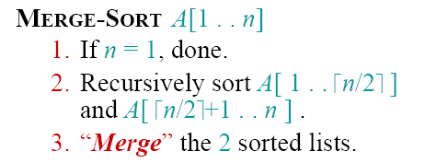


Merge Sort
How to express the cost of merge sort?

Slide 4
Merge Sort
1.Divide:Trivial.
2.Conquer:Recursively sort subarrays.
3.Combine:Linear-time merge.
# subproblems
cost of dividing and combining
subproblem
size

Slide 5
Binary search
Find an element in a sorted array:
Divide: Check middle element.
Conquer: Recursively search 1 sub array.
Combine: Trivial.
Example: Find 9
3 5 7 8 9 12 15

Slide 6

Binary search
Find an element in a sorted array:
Divide: Check middle element.
Conquer: Recursively search 1 sub array.
Combine: Trivial.
Example: Find 9

Slide 7

Binary search
Find an element in a sorted array:
Divide: Check middle element.
Conquer: Recursively search 1 sub array.
Combine: Trivial.
Example: Find 9

Slide 8

Binary search
Find an element in a sorted array:
Divide: Check middle element.
Conquer: Recursively search 1 sub array.
Combine: Trivial.
Example: Find 9

Slide 9

Binary search
Find an element in a sorted array:
Divide: Check middle element.
Conquer: Recursively search 1 sub array.
Combine: Trivial.
Example: Find 9

Slide 10

Binary search
Find an element in a sorted array:
Divide: Check middle element.
Conquer: Recursively search 1 sub array.
Combine: Trivial.
Example: Find 9

Slide 11

Binary search
Find an element in a sorted array:
Divide: Check middle element.
Conquer: Recursively search 1 sub array.
Combine: Trivial.
Example: Find 9

Slide 12


Recurrence for binary search
T(n) = 1T(n/2) + Θ(1)
b=2, a=1
Case 2 (k=0)
# subproblems
cost of dividing and combining
subproblem
size

Slide 13
Powering a Number
Problem: Compute a^{n}, where n∈N.
Naive algorithm:
How?
Complexity ?
The Spot Creativity:
Is this the only and the best algorithm?
Any Suggestions on using divide-and-conquer strategy?
Θ(n)

Slide 14
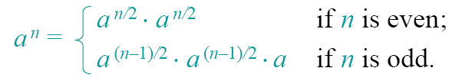

Powering a Number
Divide-and-conquer:
Complexity:
T(n) = T(n/2) + Θ(1)
a=1,b=2
=n⁰=1
case 2(k=0)
T(n) = Θ(lgn)

Slide 15

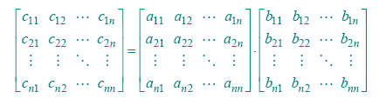


Matrix Multiplication of n*n

Slide 16


Code for Matrix Multiplication
for i=1 to n
for j=1 to n
c_{ij}=0
for k=1 to n
c_{ij}=c_{ij} + a_{ik}*b_{kj}
Running Time= ?

Slide 17
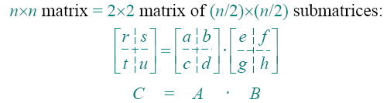
Let’s do better
How to divide-and-conquer?
Recall what we have done before.
n->n/2
Idea:
r=ae+bg; s=af+bh;
t=ce+dg; u=cf+dh;

Slide 18
Cost of Matrix Multiplication
We need:
8 recursive multiplications of matrix in size (n/2)*(n/2)
4 add operations of matrix in size (n/2)*(n/2)
Cost of adding two matrix in size n*n?
So, multiplication of matrix in size n*n takes T(n)=8 * T(n/2) + Θ(n²)
# subproblems
cost of dividing and combining
subproblem
size

Slide 19
Cost of Matrix Multiplication
T(n)=8 * T(n/2) + Θ(n²)
a=8,b=2
=n³
case 1(ε=1)
T(n) = Θ(n³)
OOPS! No better than the ordinary algorithm !

Slide 20
Strassen’s Idea
How did Strassen come up with his idea?
We should try get rid of as many mults as possible. We could do a hundred additions instead.
We can reduce the numbers of subproblems in T(n)=8 * T(n/2) + Θ(n²)
DGEMM

Slide 21
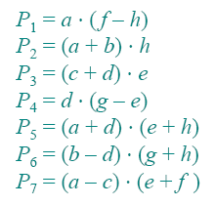

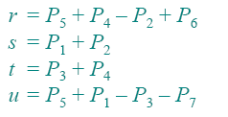
Strassen’s Idea
Multiply 2*2 matrices with only 7 recursive multiplications.
Notes: adding matrices is commutative , but multiplication is not.

Slide 22
Recall: Matrix Multiplication
r=ae+bg; s=af+bh;
t=ce+dg; u=cf+dh;

Slide 23
Strassen’s Algorithm
1.Divide: Partition A and B into (n/2)*(n/2) submatrices. Form terms to be multiplied using + and –.
2.Conquer: Perform 7 multiplications (P₁ to P₇) of (n/2)×(n/2) submatrices recursively.
3.Combine:Form C (r,s,t,u) using + and –on (n/2)×(n/2) submatrices.
Write down cost of each step
We got T(n)=7 * T(n/2) + Θ(n²)

Slide 24
Cost of Strassen’s Algorithm
T(n)=7 * T(n/2) + Θ(n²)
a=7,b=2
=n^{lg7}
case 1
T(n) = Θ(n^{lg7}) =O(n^{2.81})
Not so surprising?
Strassen’s Algorithm is not the best. The best one has O(n^{2.376}) (Be of theoretical interest only).
But it is simple and efficient enough compared with the naïve one when n>=32.

